Slide 1
Citizenship and The need of belonging
“This city is what it is because our citizens are what they are.”
Plato

Slide 2

Learning outcomes
By the end of the session you should be able to;
Identify human needs according to Maslow’s hierarchy.
Acquire and use vocabulary related to citizenship.
Develop an empathetic attitude towards global issues.
Use the 3rd conditional correctly.

Slide 3
Outline
1
Warm up
The desert island
2
Human needs
Maslow’s hierarchy of needs.
3
Citizenship and belonging
4
Global citizenship
5
Grammar: Conditional type 3
3

Slide 4
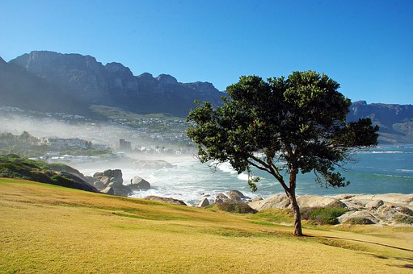
Warm up:
The desert Island
Imagine you are shipwrecked on a desert island.
In the box below are possible items that might be available to you.
Which one would you choose first?
Identify the most important item to you and explain why you would choose this item first.
Another person to talk to
A cave so that you could have a shelter
A book listing outdoor survival techniques
Excellent swimming skills
Fresh running water
Something to eat

Slide 5
Human needs
- Needs are something that you must have, in order to live.
- Human beings have certain basic needs. We must have food, water, air, and shelter to survive. If any one of these basic needs is not met, then humans cannot survive.
- Before past explorers set off to find new lands and conquer new worlds, they had to make sure that their basic needs were met.

Slide 6
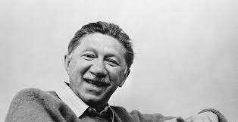
Maslow’s hierarchy of needs
Mercury
Mars
Venus
From Survive to Thrive:
Maslow defined a Hierarchy of Human Needs that stated the lower needs must be met before an individual can strive to meet the higher needs.
This theory is illustrated in a pyramid ; basic needs being at the bottom.

Slide 7
Maslow's hierarchy of needs is a model of motivation. It says people are motivated by different needs based on their life circumstances.
Guess the needs from the bottom to top.
Self-fulfillment
Mental growth
Creativity
Self-actualization
Esteem: Self-confidence, Approval, social status, personal worth
Social: Friendship, membership, social connection , belonging
Safety: Physical safety, health,protection
Physiological: Food, shelter ,clothing, sleep…( vital to survive)

Slide 8

1. The order of Maslow's hierarchy of needs, from bottom to top, is...
Safety, Belonging-Love, Self-Actualization, Self-Esteem, and Physiological
Physiological, Safety, Belonging-Love, Self-Esteem, and Self-Actualization
Psychological, Security, Happiness, Ego, and Self-Realization
Physiological, Love, Self-Actualization, Esteem, Safety
2. If a person does not feel accepted or loved, they have not reached what level, according to Maslow?
Level 1 Level 2
Level 3 Level 5
3; Self-actualization refers to...
When people realize it is all about me
When people have a lot of friends
The motivation to develop to one's full potential as a human being
When people are in meaningful relationships
4. Maslow believed that basic needs should be met in order to move to a higher level.
True false

Slide 9
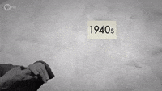
Match the correct level with the letter of the need.
A
1. I’m starving.
2. Please lock the door.
3. I hope I won’t get fired for that mistake
4. I will succeed with that new program.
5. I wish they would invite me to go to lunch.
6. I want to chair that committee.
7. Those people in that office are just mean.
8. I hope they think my idea was good.
9. I know I can be class president.
10. I’m exhausted.
Physiological Need
Safety Need
Social Need
Esteem need
Self actualization
B
B
E
C
D
C
D
E
A

Slide 10
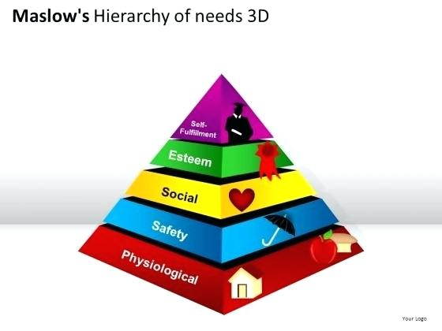
Social connection and belonging
“Man is by nature a social animal”
Aristotle

Slide 11
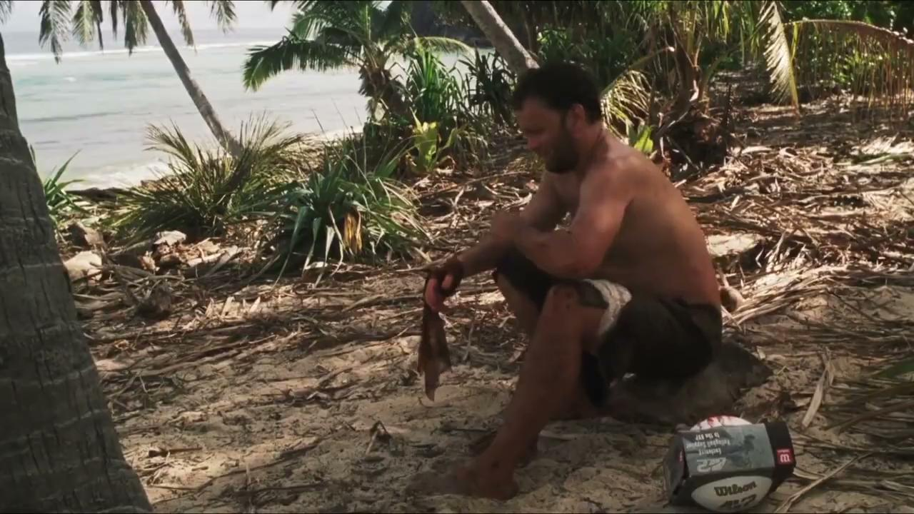

Cast away Creation of wilson

Slide 12
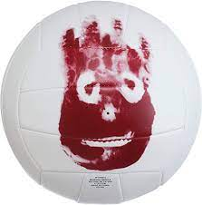
What does the volleyball Wilson represent?
Wilson is a metaphor of human need for a friend/relationship.
- Humans are social animals and like to be with other people.
- In the movie, the protagonist is lonely and devoid of social interaction. He fills this void by Wilson-the volleyball.

Slide 13

Why was Wilson so important in Cast Away?
Wilson is important to Hanks as someone who relies on him, who, in some sense, needs him. The crucial thing you lose when you fall out of society, Cast Away seems to say, is not conversation or attention.
The crucial thing you lose is the chance to be needed and to belong.

Slide 14
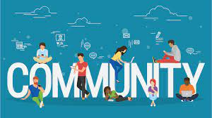
You cannot return to your home as you do not know where it is.
Why is it important to become a part of this new society?

Slide 15
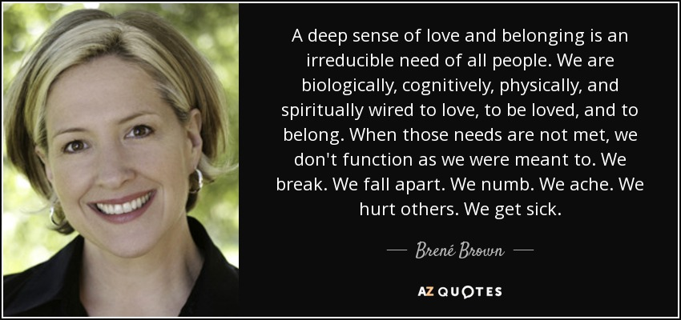

Slide 16
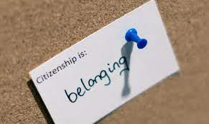
Citizenship and belonging

Slide 17
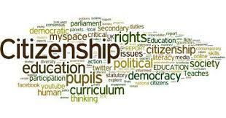
What does « Citizenship » mean?
The relationship between an individual and a state to which the individual owes allegiance and in turn is entitled to its protection.

Slide 18
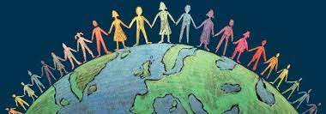
What does “Citizen” refer to?
A legally recognized subject or national of a state or commonwealth, either native or naturalized.
An inhabitant of a particular town or city.

Slide 19
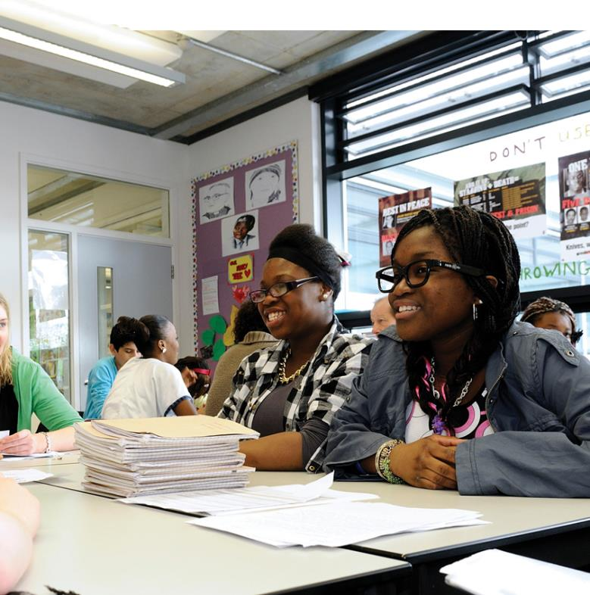

Citizenship:
A privilege
or a right?

Slide 20
Are citizens all over the world granted the same rights?
Are citizens all over the world expected to assume the same responsibilities?
The value of citizenship varies from nation to another.

Slide 21
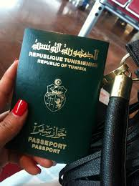
Tunisian citizenship
What are the Rights and responsibilities of a Tunisian citizen?

Slide 22
Duties | Rights
Voting / Paying taxes Obeying the laws of the community Taking part in voluntary work Protecting the environment | The right to work The right of Education The right to live in dignity (respect one’s humanity) The right to express his opinion freely Voting

Slide 23

What are the most common types of citizenship acquisition that you know?

Slide 24
        Citizenship by family
If one or both of a person's parents are citizens of a given state, then the person may have the right to be a citizen of that state as well.
Citizenship by birth
Some people are automatically citizens of the state in which they are born.
Citizenship by marriage
Many countries fast-track naturalization based on the marriage of a person to a citizen. Countries which are destinations for such immigration often have regulations to try to detect sham marriages, where a citizen marries a non-citizen typically for payment, without them having the intention of living together.

Slide 25
Citizenship by investment or Economic Citizenship.
Wealthy people invest money in property or businesses, buy government bonds or simply donate cash directly, in exchange for citizenship and a passport.
States normally grant citizenship to people who have entered the country legally and been granted permit to stay, or been granted political asylum, and also lived there for a specified period..
Naturalization.

Slide 26

Citizenship
Naturalization

Slide 27
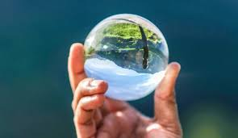
Citizenship vs Naturalization
Automatically given
Granted to people who are born to parents who are already citizens of a particular country.
Lesser requirements to apply.
Lesser time to get approval.
Granted to people who are citizens of another country.
Has lot more requirements to apply.
Requires a person to be a permanent resident of the
country for at least 5 years .
The process wherein a person who is born from another country acquires citizenship and nationality of another.
Similarity:
In both cases, the status is of an individual is legal.

Slide 28
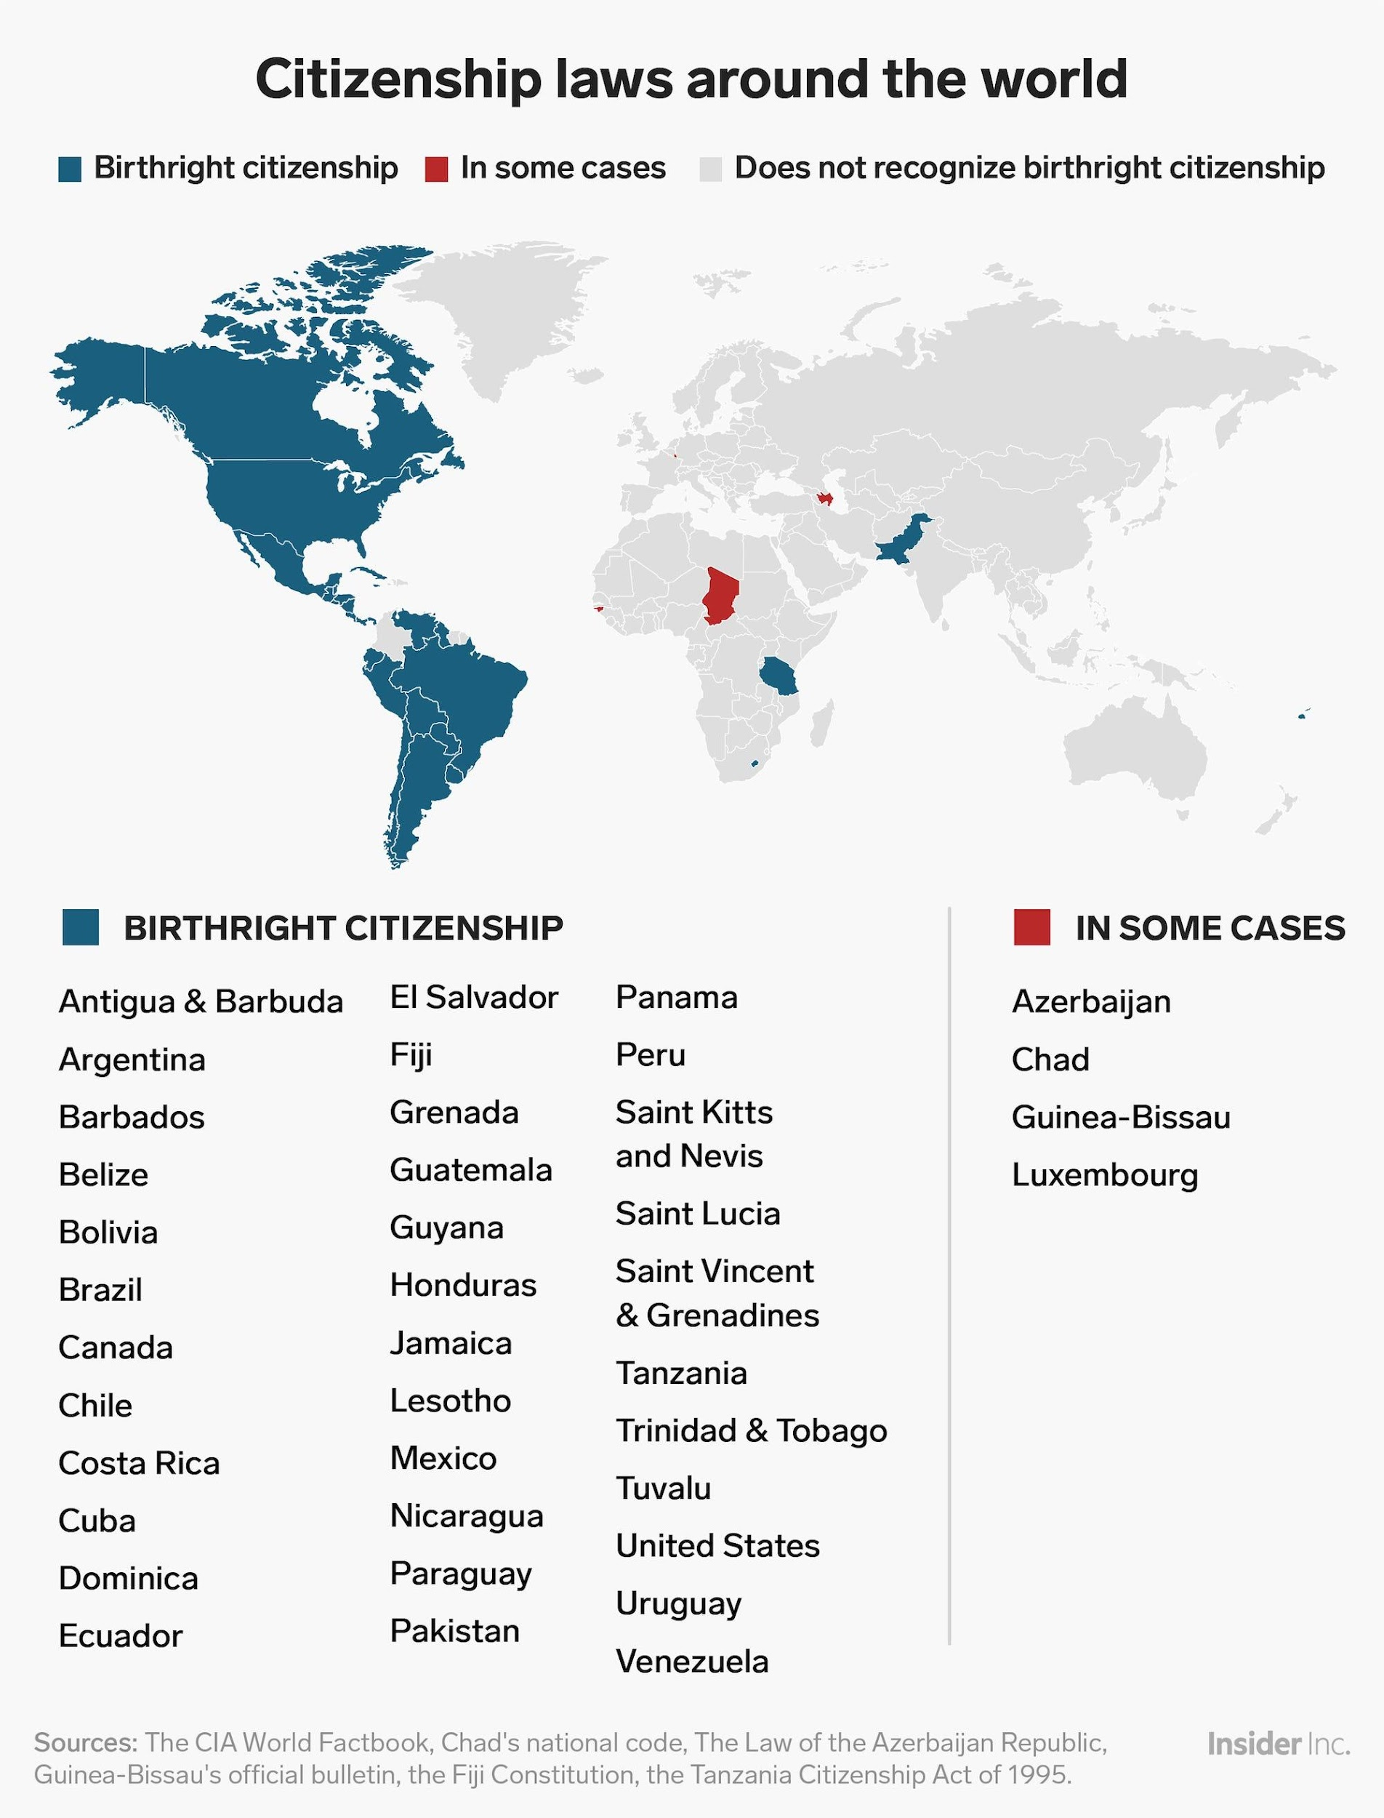

Slide 29


Can citizenship be lost?
14

Slide 30

Loss of citizenship, also referred to as loss of nationality, is the event of ceasing to be a citizen of a country under the nationality law of that country.

Slide 31
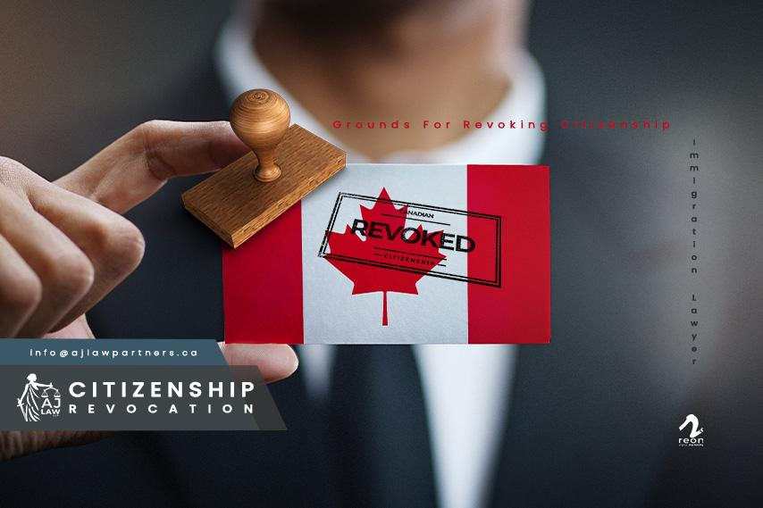
What are the most common modes of citizenship revocation that you know?

Slide 32
  Service in a foreign army
  Joining a publicly known non-state terrorist organisation
  Treason
  Acquisition of other citizenship
  Residence abroad
  Fraudulent acquisition

Slide 33
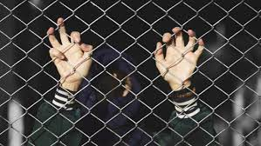
Is it morally legitimate for a state to revoke the citizenship under certain conditions?

Slide 34

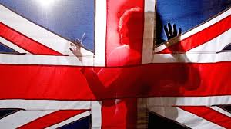
CASE STUDY: British citizenship
British Nationality Act 1981:
The Home Secretary can revoke the
citizenship of a UK born citizen if:
They think it would be ‘conducive to
the public good’
It would not make the person stateless
(i.e. if that person is also a citizen of
another country).

Slide 35
Scenario
Read through the scenario provided. Decide if you think the person described could legally have their citizenship revoked.

Slide 36
Ash is 28. She was born in Bosnia to British parents, and so had British citizenship through them. She only lived for a brief while in the UK whilst doing her A-levels when she lived with her older brother.
Although she was academically smart, she had a very short temper and was prone to violent outbursts. She also got into trouble quite a few times for being violent to other students, and ended up with a criminal record.
Because of where she was born and her criminal record, she was placed on a ‘watch list’ by British intelligence services, who noticed that she was watching a lot of extremist and violent content on the internet.
When she was 19, Ash went to Syria, claiming that she was volunteering to be an aid worker. She has now been found in a Syrian refugee camp and says she was kidnapped by ISIS.
She wants to return home, but the security services have strong suspicions that she had in fact joined ISIS. Ash denies all this. She says the online content she watched was just for research purposes.
Ash
Could have citizenship revoked

Slide 37
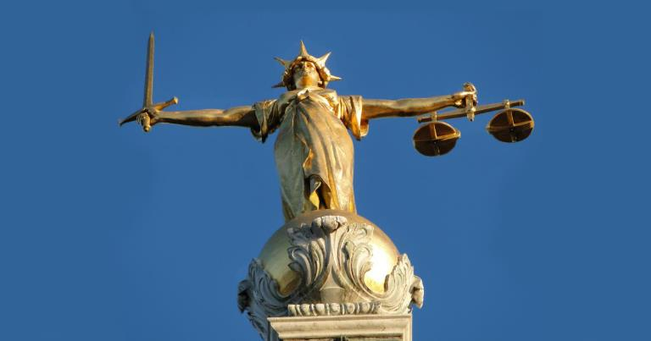
Do you think the law
is fair? Why / Why not?
What other punishments might be used rather than
having citizenship revoked?

Slide 38
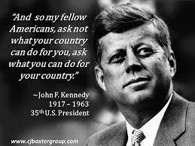

Slide 39
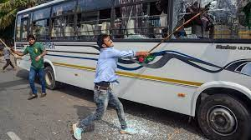
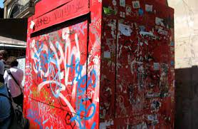
How do these pictures make you feel?
Who is responsible for this place?

Slide 40
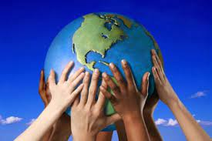
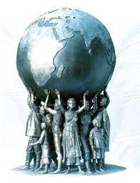
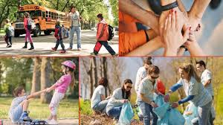
What Does It Mean to Be an Engaged Citizen?
What makes a good citizen?

Slide 41
Characteristics of an active citizen
Knowledge of the political/social/economic context of their participation
People are empowered to influence the decisions which affect their lives.
Able to challenge existing structures
Participation in the community

Slide 42
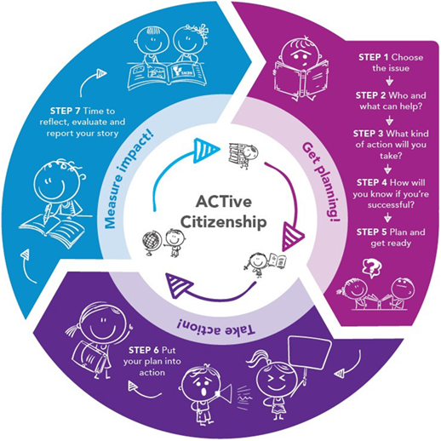
How to become an active citizen?
01
Choose the societal issue you care about, create an action plan and define your success goals.
02
Take action via petitions, advocacy or activations.
03
Measure the impact of your work to report success.
03
04
02
Create an NGO
01

Slide 43
Active citizenship
Active citizenship involves;
working for the common good in local, national and global communities, demonstrating collaborative and innovative problem solving, building relationships with diverse individuals and groups, adopting leadership roles and participating in your community.

Slide 44

Active citizenship is about
Social and moral responsibility
Community involvement
Political literacy

Slide 45
Let’s take a quiz
The principle that a person's nationality at birth is determined by the country in which they were born is called . . .
Law of blood
Law of immigration
Law of petition
Law of soil
The law of blood states . . .
All persons born to citizens of a country are themselves a citizen
All immigrants are blood citizens
All citizens must follow the law
All residents and their relatives can become citizens
What is a way that a person can exercise his or her civic responsibility?
By voting By paying attention to current events
By following law All of the above

Slide 46
What is an active citizen?
A citizen who looks the other way when he/she sees an injustice
A citizen who is a member of the local council
A citizen who actively helps his/ her community
A citizen who is physically active
Citizens acting alone or together to protect public values or make a change in the community is called . . .
Civic engagement
A duty
Common good
An obligation
A foreign-born resident who has not been naturalized is a . . .
Resident Resident Alien
Immigrant citizen

Slide 47
The belief that people should work for social and political change is called . . .
Resident
Petition
Law of soil
Common good
Naturalization is . . .
The process to become an immigrant
The steps to becoming a resident
The process to get a work permit
A legal process to obtain citizenship
Which of the following is a way citizens can go above and beyond their basic civic responsibilities?
Vote Pay taxes
Respecting and obeying the law
Making connections and building social and working relationships with people from other cultures

Slide 48
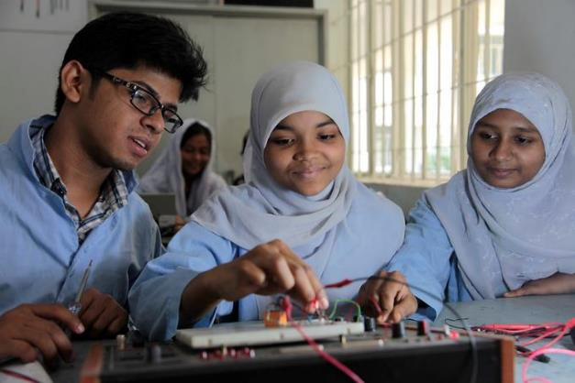
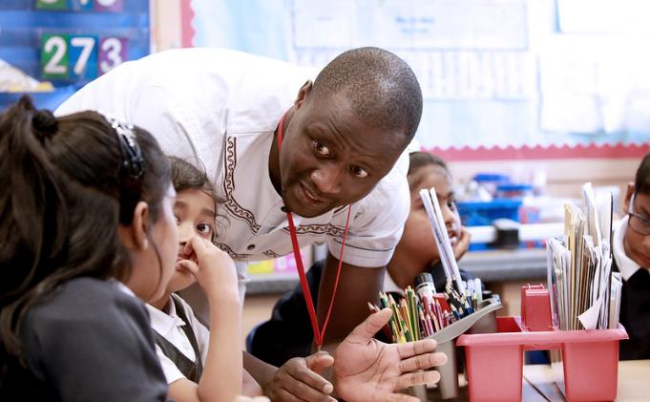
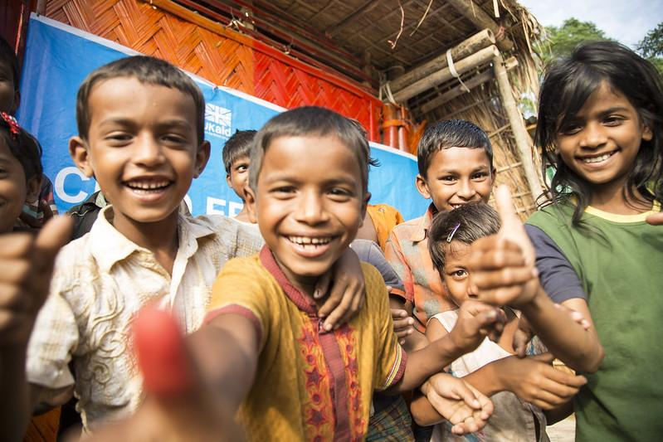
Beyond active citizenship
Global citizenship

Slide 49
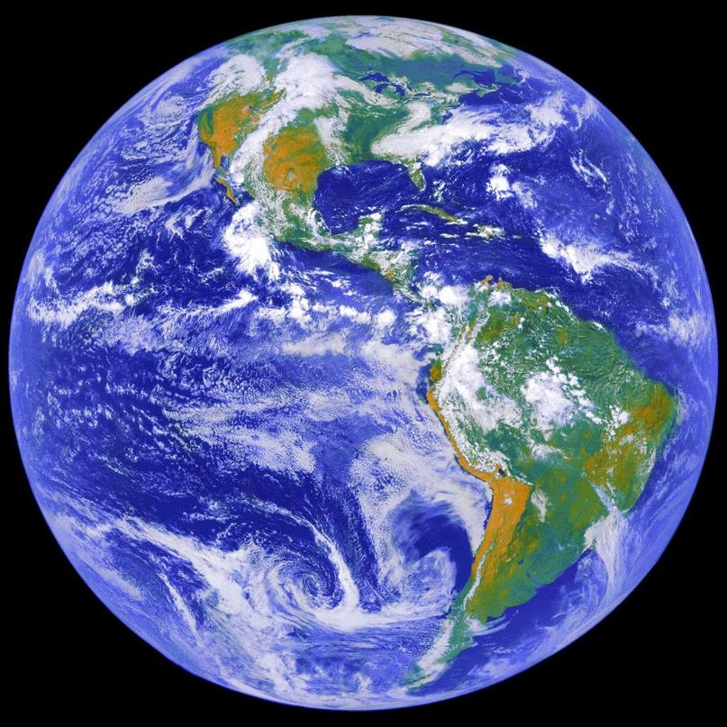
What would you like to change?
Injustice
Climate change
Hunger
Inequality
War
Poverty
www.britishcouncil.org
‹#›
Notes:
Image: NASA, https://images.nasa.gov/details-0202795
‹#›

Slide 50
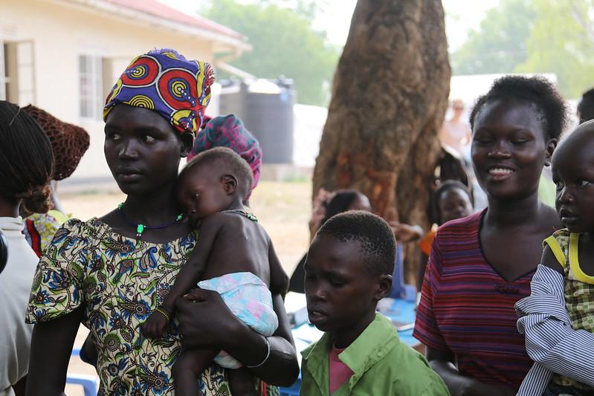
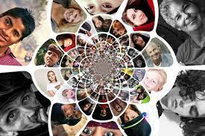
Who has the most power to change things?
What do you think you can do?

Slide 51
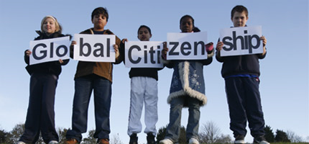

What does global citizenship mean?
Global citizenship is about the shared human experience.
It acknowledges and celebrates that, wherever we come from and wherever we live, we are here together.
Our well-being and success are ultimately interdependent.

Slide 52

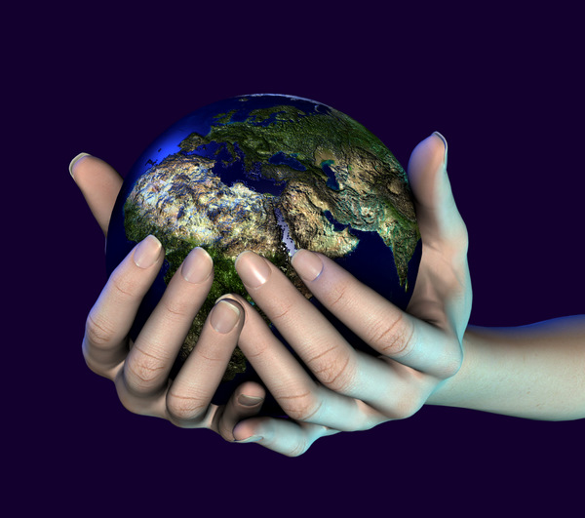


When something happens on one side of the world, it affects people on the other side of the world, because we are all connected!
As global citizens, we recognise we are all citizens of one planet to which we have a responsibility, whatever our beliefs

Slide 53
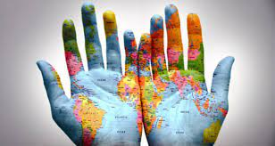
“I am not an Athenian, or a Greek, but a citizen of the world”
Socrates
A global Citizen is someone who:
Takes an active role in their community and work with others to make our planet more peaceful, sustainable and fairer.
Is aware of and understands the wider world – and their place in it.
Places their identity with a « global community » above their identity as a citizen of a particular nation.

Slide 54
To wrap up
- A world citizen understands that we are connected, and works to help everyone have the same human rights no matter where they live.
- A world citizen respects all cultures and religions, even if they do things a little differently than we do.
- A world citizen knows that there are many different perspectives and different ways to solve problems. We should be a good role model for others, take responsibility for our actions, and have compassion for others around the world.
- A world citizen works with others to protect our planet and to fight inequality., injustice , war….

Slide 55
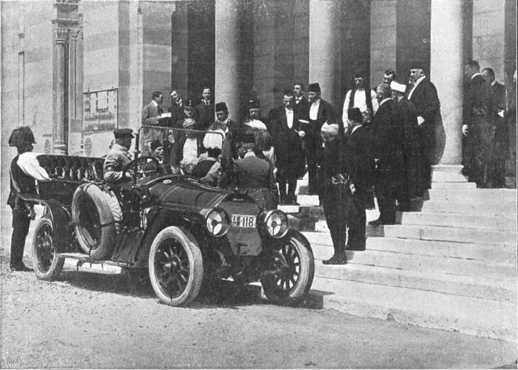
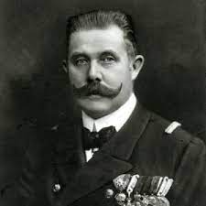
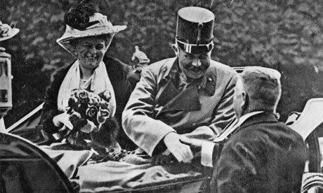
Could World War I Have been Avoided?
World War One could have been prevented, if Archduke Franz Ferdinand had survived the assassin's bullet.

Slide 56

Did Archduke Franz Ferdinand survive?
Was WWI prevented?

Slide 57

Going BACK in TIME to the PAST
The 3rd Conditional
What would you have done differently?

Slide 58
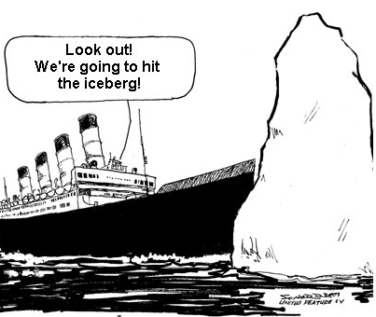
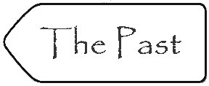
FORM
If the Titanic had missed the iceberg, it wouldn't have sunk.
If
Past perfect
Would/could/might (not) +have+PP
MEANING
We use third conditional to talk about hypothetical or unreal situations in the past.

Slide 59
We can use "could" or "might" instead of "would" in the main clause of the third conditional.
If they had known about the problems with the trains, they would have driven.
The main clause with "would" describes a certain result.
If they had known about the problems with the trains, they could have driven.
The main clause with "could" describes a possible result as an ability to do something.
If they had known about the problems with the trains, they might have driven.
The main clause with "might" describes a possible result.

Slide 60
Going BACK in TIME to the PAST
Practise
Sentence transformation
Make sentences for the pictures in the 3rd conditional

Slide 61
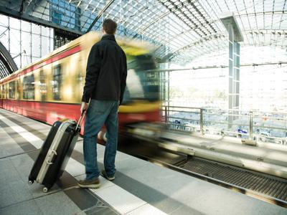
He arrived late and missed the train.
If he hadn’t arrived late, he wouldn’t have missed the train

Slide 62
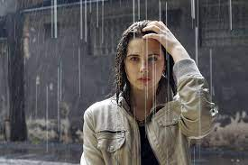
She forgot her umbrella and got wet
If she hadn’t forgotten her umbrella, she wouldn’t have got wet

Slide 63
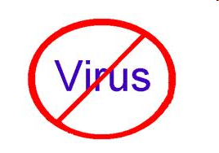
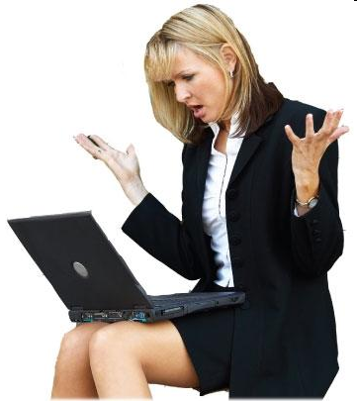

She got a virus on her laptop because she didn’t install an antivirus
If she had installed an antivirus on her laptop, she wouldn’t have got a virus

Slide 64
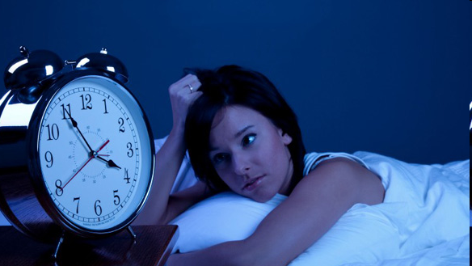

She drank so much coffee yesterday, she couldn’t sleep last night
If she hadn’t drunk so much coffee yesterday, she would have been able to sleep last night

Slide 65
3rd conditional : Other expressions
Unless =if not
  I wouldn’t have arrived on time unless I had taken a taxi.
  I wouldn’t have arrived on time if I hadn’t taken a taxi.

Slide 66
Conditional clause | Main clause
"If only" + subject + past perfect + comma | subject + "would have" / "could have"
If only I had taken the train, | I would have / could have arrived by now.
If only
Wish
Conditional clause with "wish" | Main clause
Subject + "wish" + subject + past perfect + semicolon | subject + "would have" / "could have"
I wish I had taken the train. | I would have / could have arrived by now.

Slide 67

Complete the following sentences;
If she hadn't got the job,……………………………………………………………..
They’d have passed their exams if they ……………………………………………..
Unless we'd invited them,…………………………………………………………………….
If only they had started earlier, ………………………………………………………………

Slide 68
Circle the correct option
1. I .................. you if you .................. me.
  A. Would have helped- had asked
  B. Had helped- would have asked
  C. Would have helped - would have asked
2. If they .................. earlier, they .................. the train.
  A. Would have left, had caught
  B. Had left, had caught
  C. Had left, would have caught
3. If you .................. more, you .................. so tired.
  A. Had slept, hadn't been
  B. Had slept, wouldn't have been
  C. Would have slept, wouldn't have been
  4. He .................. the exam if he .................. harder.
  A. Had passed, would have studied
  B. Would have passed, had studied
  C. Had passed, had studied
  5. If I .................. an umbrella, I .................. wet.
  A. Had taken, wouldn't have got
  B. Had taken, had got
  C. Would have taken, hadn't got
  6. If they .................. on holiday in June, the weather .................. better.
  A. Were, would have been
  B. Would have been, would have been
  C. Had been, would have been

Slide 69


